Slide 1
Introduction to Machine Learning
Notes:
<number>

Slide 2
Introduction to Machine Learning
Introduction + Motivation
“Machine learning is the scientific study of algorithms and statistical models that computer systems use to perform a specific task without using explicit instructions, relying on patterns and inference”
Importance and future of machine learning
Why this is an era of machine learning
Notes:
<number>

Slide 3
Introduction to Machine Learning
Importance and future of machine learning
History of machine learning
Most widely used branch of computer science nowadays(google)
Notes:
<number>

Slide 4

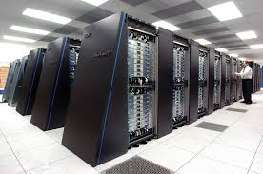
Introduction to Machine Learning
Why this is an era of machine learning
Powerful machines that can handle computations quickly
Availability of huge amount of data
Advancement of technology and knowledge among people
Notes:
<number>

Slide 5
Introduction to Machine Learning
Learning from data
How kids learn
How computer learns
Learning of kids vs Learning of computers
Notes:
<number>

Slide 6

Introduction to Machine Learning
How kids learn
Kids learn by observing, listening to various things (data) and recognizing them without following any set of rules
Notes:
<number>

Slide 7
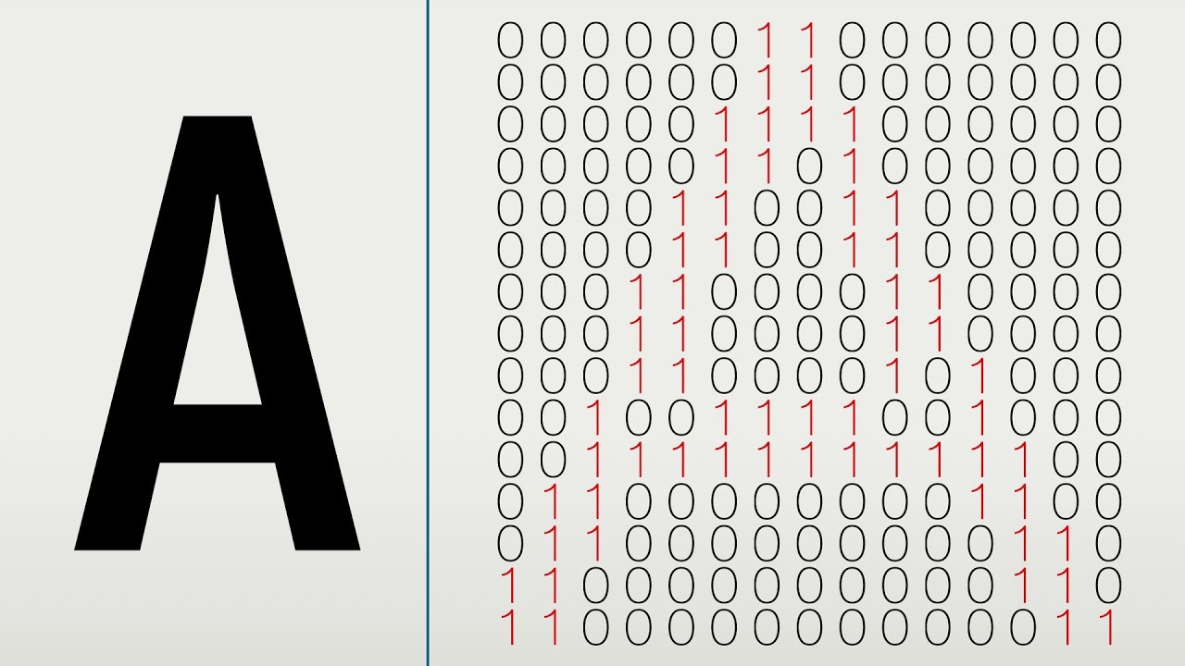
Introduction to Machine Learning
How computer learns
Computer learns by algorithms provided to it following a set of rules, for observing and finding patterns from the given data
Notes:
<number>

Slide 8
Introduction to Machine Learning
Learning of kids vs Learning of computers
“We should raise AIs like parents, not programmers—or they’ll turn into terrible toddlers”
Both are learning on the basis of the data given to them
In the beginning, both will make mistakes
If data is not clear, learning will not be good and vice versa
Learning is directly proportional to the amount of data
Notes:
<number>

Slide 9
Introduction to Machine Learning
Learning from data
Dataset
Training data
Testing data
Outliers
Model
Training a model
Over fitting
Under fitting
Labels
Features
Accuracy
Error
Notes:
<number>

Slide 10
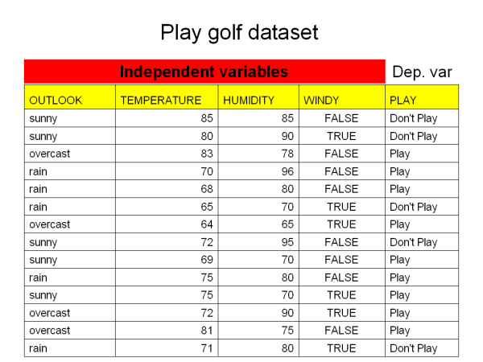
Introduction to Machine Learning
Dataset
A data set (or dataset) is a collection of data.
Dataset is a table, where every column of a dataset represents values of a particular variable, and each row corresponds to a given record of the dataset.
Each value in the dataset is regarded as a datapoint
The last column of data usually contains labels
Notes:
<number>

Slide 11
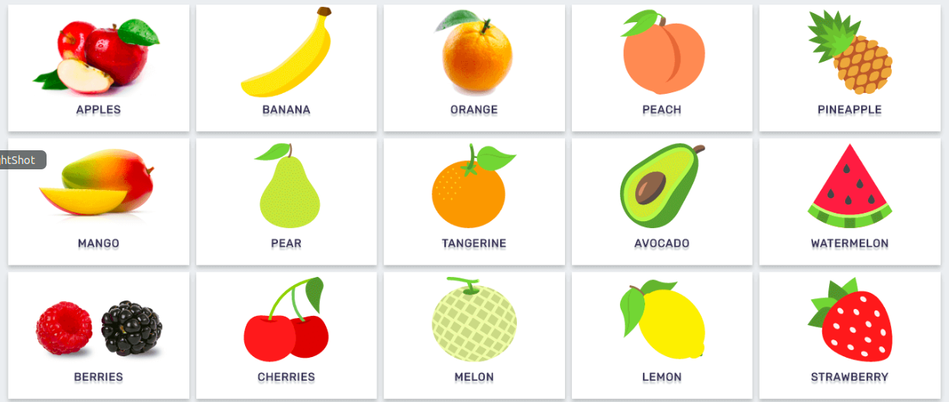
Introduction to Machine Learning
Label
A label or target is referred as the output of the data.
A labelled dataset contains label which can be any output to classify the data such as cats or dogs, 0s or 1s.
When a model is trained it predicts the labels of the data given to it also known as classes
In machine learning, if labels are not in numeric form, then we convert them into numeric form
For example Apple=0, Pear=1, etc
Notes:
<number>

Slide 12
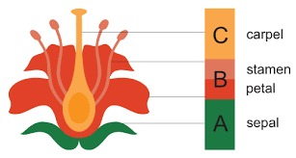
Introduction to Machine Learning
Features
A feature is an individual measurable property or characteristic of a phenomenon being observed.
Previously we used the term data points, in machine learning data points are formed by features.
A feature is a finite number which is observed by the observer
There are a lot of feature extraction techniques available
Performance of Model depends a lot on the features that we have selected
Notes:
<number>

Slide 13
Introduction to Machine Learning
Splitting the data
Training data
Testing data
Notes:
<number>

Slide 14
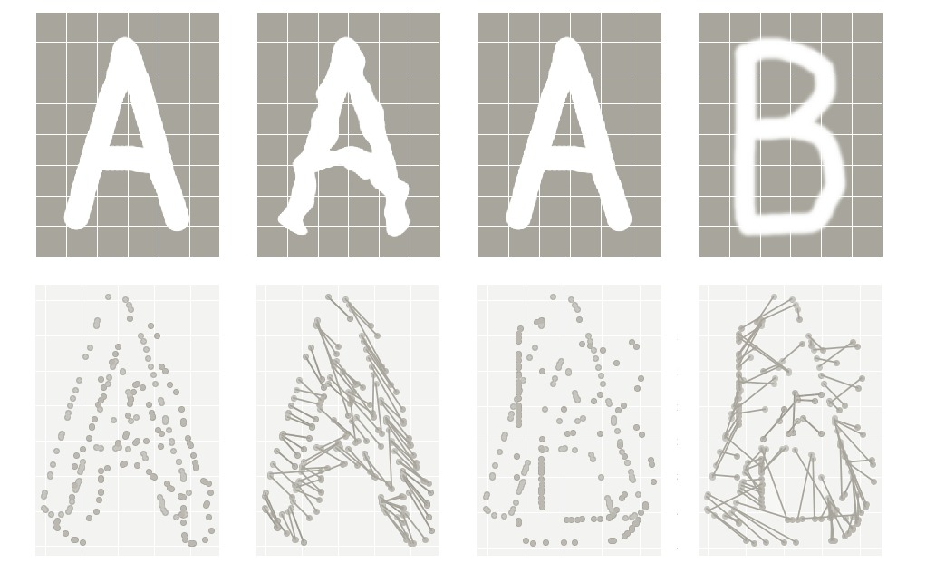
Introduction to Machine Learning
Training data
A machine learns from data. It finds relationships, and patterns from data.
The data provided to the machine to learn and train itself is called training data.
Notes:
<number>

Slide 15
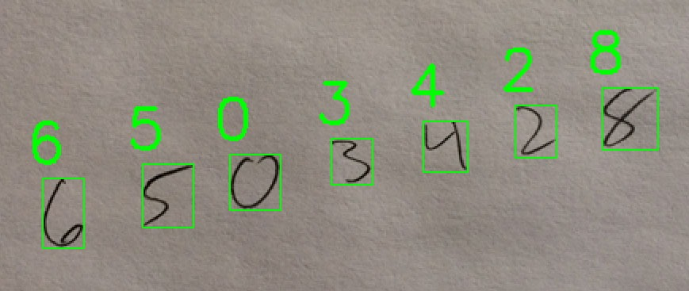
Introduction to Machine Learning
Testing data
Once the machine is trained by using training data, in order to test the machine if it is working fine or not, we use another set of data which should not be the same data on which the model was trained,known as testing data
Notes:
<number>

Slide 16
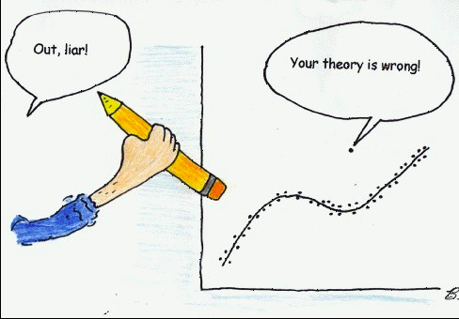
Introduction to Machine Learning
Outliers
In the dataset there might be some data points that differ from all other data points
Outliers are normally excluded from the dataset.
They can be identified by visualizing the dataset
Notes:
<number>

Slide 17
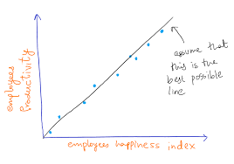
Introduction to Machine Learning
Model
A machine learning model is a mathematical equation or expression that tries to fit the data and learn to predict the unseen data
Notes:
<number>

Slide 18
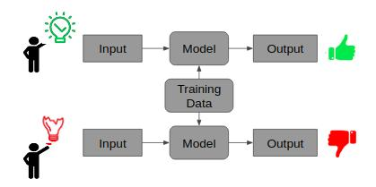
Introduction to Machine Learning
Training a model
The process of trying to fit the training data into a model through a machine learning algorithm to achieve a pattern in the data for predicting an unseen data is known as training a model
Notes:
<number>

Slide 19

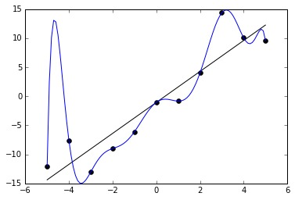
Introduction to Machine Learning
Overfitting
Overfitting is a modeling error when the model performs well on the training set but poorly on the testing set or any other data.
Overfitting occurs when the model is very flexible and is forcefully fitted to most of the data points in the training set.
In overfitting, the model shows high variance but low bias
Cramming the syllabus just before exam night :)
Notes:
<number>

Slide 20

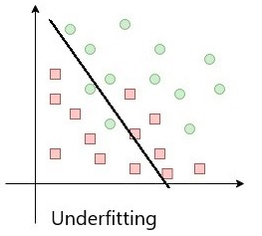
Introduction to Machine Learning
Underfitting
Underfitting is when model does not perform well on the training set neither on the testing data or any other data.
Underfitting occurs when the model is not flexible at all.
In underfitting, the model shows low variance but high bias.
Notes:
<number>

Slide 21


Introduction to Machine Learning
Accuracy
The term Accuracy is known as Classification accuracy or accuracy of a model.
It is the ratio of number of correctly predicted classes to the total number of input samples for testing.
It is known to be good if correctly predicted classes approaches to total number of samples.
Formula of accuracy(%): correct predictions/total number of predictions * 100
Notes:
<number>

Slide 22
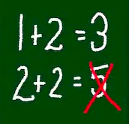
Introduction to Machine Learning
Error
Similarly the ratio of number of wrongly predicted classes to the total number of input samples is known as the error of the model.
A model is known to be good If it's error is close to zero
Formula of error(%): Incorrect predictions/total number of predictions * 100
Notes:
<number>

Slide 23
Introduction to Machine Learning
Importance of data in machine learning
Formats of data
Structured data
Labeled data
Unlabeled data
Unstructured data
How to choose the best format of data
Notes:
<number>

Slide 24
Introduction to Machine Learning
How to choose the best format of data
Articulate the problem early
Establish data collection mechanisms
Format data to make it consistent
Reduce data
Decompose data
Normalize the data
Discretize data
Notes:
<number>

Slide 25
Introduction to Machine Learning
Types of learning
Supervised learning
Un-supervised learning
Notes:
<number>

Slide 26
Introduction to Machine Learning
Supervised learning
Supervised learning is a type of learning in which the input and output data are labelled for classification.
We train the machine using data which is labeled that means that data has an output.
The term supervised learning comes from the idea that an algorithm is learning from a training dataset, which can be thought of as the teacher.
Notes:
<number>

Slide 27
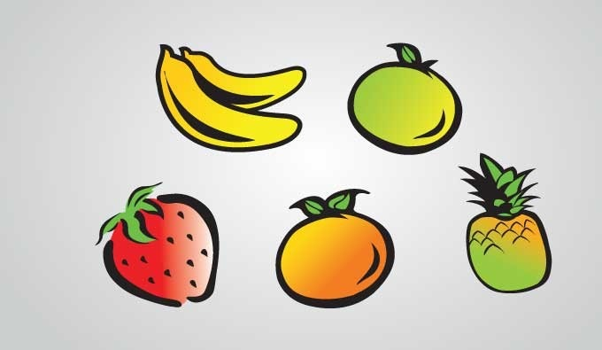
Introduction to Machine Learning
Unsupervised learning
Unsupervised learning is a type of learning in which the data is neither classified nor labeled and allowing the algorithm to act on that information without any guidance.
In this scenario, task of machine is to group unlabelled dataset according to similarities, patterns and differences without any prior training of data unlike supervised learning there is no teacher to supervise
Notes:
<number>

Slide 28
Introduction to Machine Learning
Modes of Machine learning
Classification
Regression
Clustering
Notes:
<number>

Slide 29
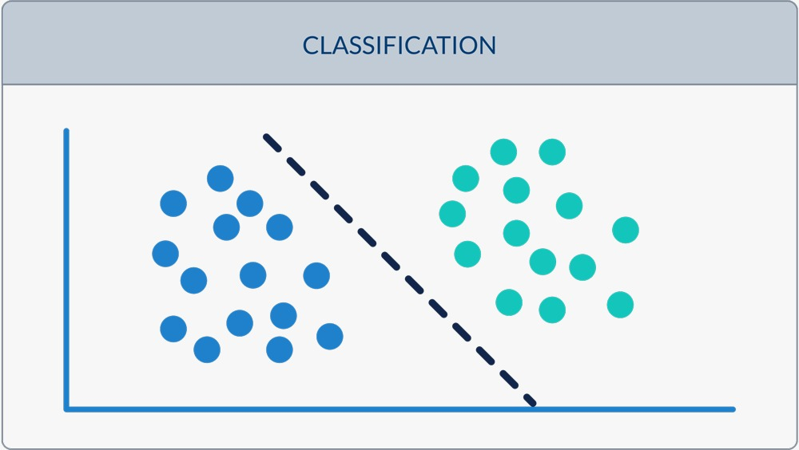
Introduction to Machine Learning
Classification
Classification is the further branch of supervised learning,as we already know that supervised learning requires labelled dataset, a classifier predicts the class of features given to the model such as 0s or 1s or spam or not spam.
Some of Classifiers algorithms are as follows
Logistic Regression.
Nearest Neighbor.
Support Vector Machines.
Decision Trees.
Random Forest.
Notes:
<number>

Slide 30
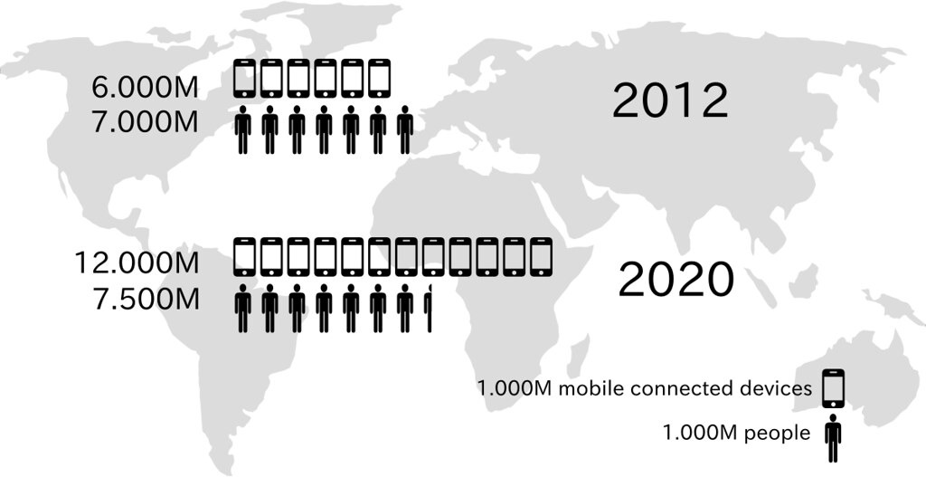
Introduction to Machine Learning
Regression
Regression is also a branch of supervised learning in which the output variable Is a real or continues value such as number dollars, miles and salary.
Regression is used to predict a continuous value like estimated price of a house.
Some of the regression algorithms are as follows:
Linear Regression.
Polynomial Regression.
.
Notes:
<number>

Slide 31
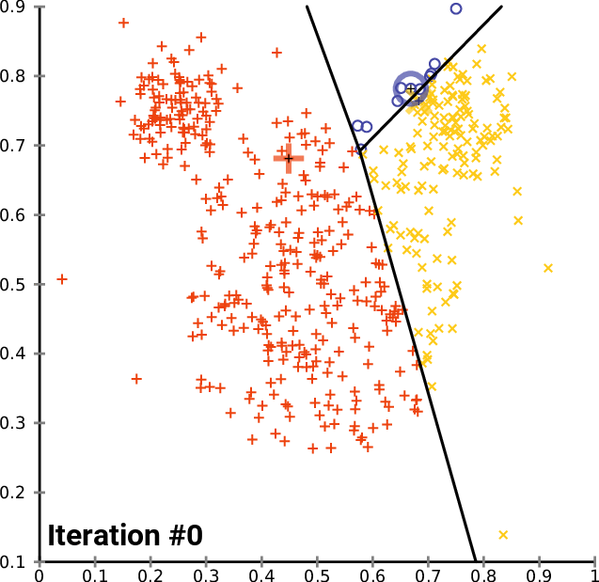
Introduction to Machine Learning
Clustering
Clustering is a branch of unsupervised learning that involves the grouping of similar features because there are no labels to classify them.
We can use a clustering algorithm to classify each data point into a specific group.
Notes:
<number>

Slide 32
Introduction to Machine Learning
Clustering
The data points that are in the same group should have similar features, while data points in different groups should have highly dissimilar features.
Some of the clustering algorithms are as follows:
K-means Algorithm.
Fuzzy C-means (FCM) Algorithm.
Expectation-Maximisation (EM) Algorithm.
Hierarchical Clustering Algorithms.
Notes:
<number>

Slide 33
Introduction to Machine Learning
A general flow of a typical Machine learning project
Data collection
Feature extraction
Data preprocessing
Model training
Testing
Validation
Repeat/Happy Ending
Notes:
<number>

Slide 34
Let’s get started with Random Forest
Notes:
<number>

